Slide 1


Conagra Project

Slide 2
Introduction to Conagra Brand
Conagra Brands, Inc. (formerly ConAgra Foods) is an American consumer packaged goods holding company headquartered in Chicago, Illinois. Conagra makes and sells products under various brand names that are available in supermarkets, restaurants, and food service establishments. Based on its 2021 revenue, the company ranked 331st on the 2022 Fortune 500.
BRANDS:
Conagra’s iconic brands, such as Birds Eye, Duncan Hines, Healthy Choice, Marie Callender's, Reddi-wip, and Slim Jim, as well as emerging brands, including Angie's BOOMCHICKAPOP, Duke's, Earth Balance, Gardein, and Frontera, offer choices for every occasion.
Table Spread:
Margarine/Table spread is a blend of oils that are mostly unsaturated fat. Butter is made from cream or milk. The type of fat found in animal products, such as cream, is mostly saturated fat. People look for a spread that has the least amount of saturated fat.
Margarine often tops butter when it comes to heart health and is slowly replacing it.
Conagra offers table spreads under various brands such as Blue Bonnet, Smart Balance, Earth Balance, Parkay.

Slide 3
Conagra Table spread
Objective: To increase the sales of conagra table spreads.
The market size of table spread in the USA is 29.9 billion USD as per 2023 and the overall market value is expected to reach 53.2 billion USD by 2033.
The market size is near to doubling in the next ten years. So there is a high scope to capture the target customers. Some of the competitors of Conagra table spreads are Private label, Land O Lakes, Country Crock, Kerry gold, ICBINB, Challenge. We can also target the consumers of Cooking Spray and Cooking & Salad Oils to make conversions to table spreads.
Below are few observations regarding the sales of Conagra products:
CAG’s market share when compared to its competitors is 5.23 %(within food processing business)
CAG yearly revenue as per 2022 is 12,575.90 million dollars
The quarter growth rate of Conagra has always been positive
The growth rate of customers has been positive
So we can conclude that though there is an increasing trend in sales, we need to accelerate the rate.

Slide 4
Challenges
Potential challenges with Mass Merchandising :
Targeted Marketing: Understanding the target audience and tailoring the marketing campaign to their needs and preferences is crucial for increasing sales. This could include using social media, email marketing, or other advertising channels to reach potential customers.
Product Placement: The placement of the product in the store can have a significant impact on sales. Ensuring that the product is positioned in a high-traffic area or at eye-level can help increase visibility and generate more sales.
Promotions and Discounts: Offering discounts, coupons, or promotional deals can entice customers to purchase the product, particularly if it is new or has not yet established a strong market presence.
Product Innovation: Introducing new features or improvements to an existing product can help increase sales by attracting customers who may be interested in trying out the new and improved version.
Customer Service: Providing excellent customer service can help build customer loyalty and generate repeat business. Satisfied customers are also more likely to recommend the product to others, which can increase sales.
Branding and Packaging: A strong brand identity and attractive packaging can make the product stand out on the shelves and catch the attention of potential customers

Slide 5
Market research and statistical Analysis
Analysis has been done on various attributes including regional, seasonal, price and regression analysis.
Also, market research has been done on other competitive brands to arrive at the conclusions and provide solutions to increase the sales of table spread products.
We have arrived at following conclusions basis each analysis

Slide 6




Region wise Analysis: The south central and south-east regions, which have strong potential for table spreads but have less merchandising, can boost their merchandising. With merchandising, we can quantify the 2% of cooking oil and spray sales. Compared to the Plains, which contribute the least to total sales, the Northeast Region contributes the most. To enhance the overall sales of table spread, we can attempt expanding the promotions in the plains and west regions.
Tablespread
Geography_1 | Unit Sales Any Merch | Unit Sales No Merch | Total Unit sales | Mech%
California | 158,962,500 | 366,876,700 | 525,839,100 | 30%
Great Lakes | 386,093,500 | 646,442,600 | 1,032,536,000 | 37%
Mid-South | 236,098,300 | 644,788,200 | 880,886,500 | 27%
Northeast | 435,610,300 | 841,586,600 | 1,277,197,000 | 34%
Plains | 177,429,300 | 312,801,100 | 490,230,400 | 36%
South Central | 148,048,500 | 568,659,900 | 716,708,400 | 21%
Southeast | 255,729,500 | 755,348,600 | 1,011,078,000 | 25%
West | 288,197,000 | 435,226,100 | 723,423,100 | 40%
Cooking and salad oil
Geography_1 | Unit Sales Any Merch | Unit Sales No Merch | Total Unit sales | Mech%
California | 72,634,430 | 134,363,600 | 203,284,300 | 36%
Great Lakes | 54,704,560 | 185,356,000 | 238,356,300 | 23%
Mid-South | 59,015,000 | 239,048,800 | 297,125,700 | 20%
Northeast | 74,654,920 | 222,140,700 | 294,201,300 | 25%
Plains | 22,187,850 | 95,427,320 | 116,821,000 | 19%
South Central | 75,798,580 | 259,936,000 | 333,595,000 | 23%
Southeast | 107,776,900 | 300,954,900 | 407,207,300 | 26%
West | 39,781,630 | 143,524,900 | 182,458,400 | 22%
Cooking spray
Geography_1 | Unit Sales Any Merch | Unit Sales No Merch | Total Unit sales | Mech%
California | 9,002,911 | 37,911,800 | 46,361,970 | 19%
Great Lakes | 17,284,400 | 74,726,370 | 91,595,420 | 19%
Mid-South | 15,870,490 | 88,685,430 | 103,922,200 | 15%
Northeast | 19,969,040 | 97,550,770 | 116,805,000 | 17%
Plains | 7,773,952 | 40,923,280 | 48,347,060 | 16%
South Central | 10,129,740 | 74,267,710 | 83,844,050 | 12%
Southeast | 29,390,560 | 94,285,170 | 123,161,600 | 24%
West | 11,776,100 | 55,137,090 | 66,561,650 | 18%

Slide 7
Seasonal affect Analysis: Although the sales distribution for cooking oil and cooking spray is essentially consistent across all quarters, the trend for table spread is different. In comparison to other quarters, Q4 sales are high. Therefore, by improving marketing and deals, there is room to increase table spread sales in other areas as well.
Tablespread
Quarter | Unit Sales Any Merch | Unit Sales No Merch | Total Unit sales | % share of quarter
Q1 | 897,375,300 | 2,266,160,000 | 2,977,527,000 | 24%
Q2 | 887,848,700 | 2,209,936,000 | 2,881,574,000 | 23%
Q3 | 761,064,000 | 2,248,059,000 | 2,809,515,000 | 23%
Q4 | 1,632,728,000 | 2,431,097,000 | 3,797,485,000 | 30%
Cooking oil
Quarter | Unit Sales Any Merch | Unit Sales No Merch | Total Unit sales | % share of quarter
Q1 | 116,732,300 | 399,566,800 | 512,644,800 | 25%
Q2 | 105,119,300 | 402,818,200 | 504,042,500 | 24%
Q3 | 102,603,700 | 405,697,600 | 504,915,800 | 24%
Q4 | 182,098,600 | 372,669,800 | 551,446,400 | 27%
Cooking spray
Quarter | Unit Sales Any Merch | Unit Sales No Merch | Total Unit sales | % share of quarter
Q1 | 25,611,150 | 143,378,000 | 167,829,900 | 25%
Q2 | 28,592,830 | 142,440,400 | 170,058,700 | 25%
Q3 | 20,452,550 | 143,000,200 | 162,507,000 | 24%
Q4 | 46,540,670 | 134,669,000 | 180,203,400 | 26%

Slide 8
Buyer Class distribution: Based on the distribution of classes, we can see that Conagra has a chance to convert sales of non-Conagra items for upper class consumers. To take 4% of that market, we might consider introducing premium products.
Class Distribution | Conagra | Non-Conagra
Lower (<$30k 1P + $5k per add`l Person) | 27.20 | 27.49
Middle ($30-70k 1P + $5k per add`l Person) | 39.62 | 39.16
Upper (>=$70k 1P + $30k all others ) | 33.17 | 37.00

Slide 9
Price Range Analysis : One major finding is that the average price per unit is rising as the items are grouped into clusters based on market share, with cluster 1 housing the products with the majority market share. We can therefore conclude that the best sales are for products with moderate price ranges.
cluster | Average price per unit
Cluster 1 | 3.59
Cluster 2 | 3.91
Cluster 3 | 4.65
Cluster 4 | 5.37
Cluster 5 | 6.50
Conagra | 3.55

Slide 10
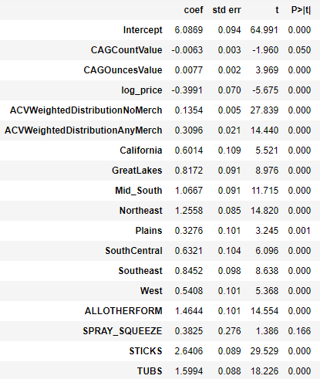
Regression Analysis
Conagra's product prices are moderate, which is perfect for boosting sales. With 1% increase in price, sales decreases by 0.39%. So we can continue with the same.
Sticks are the most popular form of table spread and have the biggest sales contribution. Also, the number of items in each bundle has the opposite effect on sales. So we can restrict the production of 12 CT and 16 CT products.

Slide 11
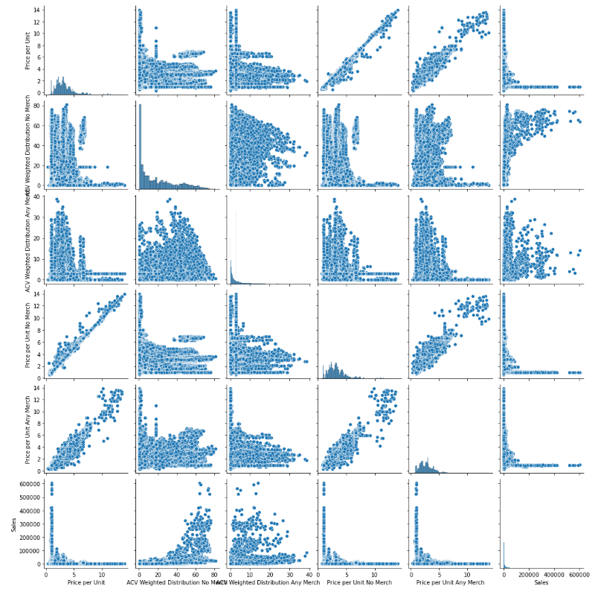
Category wise analysis
The visualization combines scatter plots and histograms for the table spread category for the year 2018 using various attributes, including price per unit, ACV weighted distribution with no merchandising, ACV weighted distribution with merchandising, price per unit with merchandising, and sales across all locations. We can see from the pair-wise plot that Sales appears to have a strong relationship with ACV no merch and does not appear to have a linear relationship with Price.

Slide 12
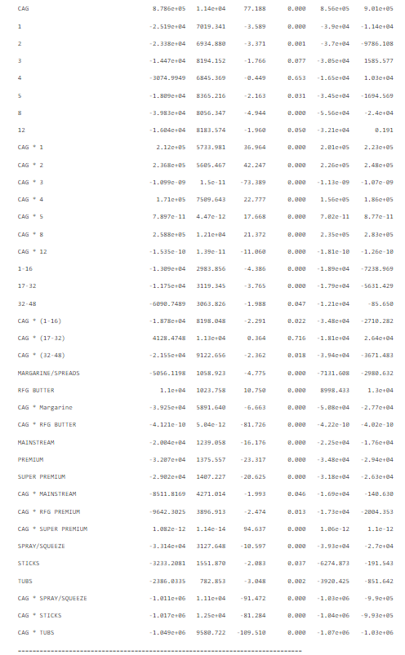
Product Attribute Analysis
The analysis shows the significant impact of product attributes on sales performance, including merchandising, tier value, form, count value, ounces value, and sub-category. Conagra's overall sales are lower than those of its competitors, however certain attributes, such as the 8CT count value and particular ounces and sub-category ranges, help Conagra goods sell better.

Slide 13
Impact of price
The analysis of the regression models for the impact of price on butter brands across different years provides valuable insights. It is evident that the effect of price on sales varies significantly among different brands, with some brands showing a positive impact on sales with higher prices while others experience a negative impact. Earth Balance consistently demonstrates higher perceived value and pricing power, while Move Over Butter and Nucoa appear to be more price-sensitive. These findings suggest that Conagra can tailor their pricing strategies based on brand characteristics and customer preferences to optimize sales and maximize value.

Slide 14
Cannibalization
Cooking oil and cooking sprays produced by Conagra, such as Wesson oil and PAM spray, are commonly used as a substitute for butter and margarine in cooking and baking. These products are often preferred by those who want to reduce their intake of saturated fat and calories.
While cooking oils and sprays can be used in a similar way to butter and margarine, they do not have the same taste and texture. Therefore, they are not considered a complement to table spreads like butter and margarine.
However, some people may use both cooking oils/sprays and butter/margarine in different ways in their cooking and baking. Overall, cooking oils and sprays are often seen as a healthier substitute for butter and margarine.

Slide 15
Other Miscellaneous Strategies
Another strategy we can implement is positioning the conagra products next to pricey products in places like Walmart so that customers will choose them since they are more affordable.
As another simple way to increase sales, we may also agree to have Conagra items placed at eye level at retail establishments.
Another strategy that can be used to promote Conagra products is to distribute more products to restaurants and retail establishments as trial and testers. This will result in more sales in the long run.

